Slide 1
Anesthetic Considerations for Diastolic Dysfunction
Suneel.P.R
Associate Professor
SCTIMST
Trivandrum

Slide 2
Dysfunction: systolic vs. diastolic
Systolic function is intuitively meaningful
Diastology is a relative newcomer

Slide 3
Diastolic damages
Nearly 50% of all cardiac failures
Prognosis and mortality same as systolic
Mortality is four times when compared with normal population

Slide 4
Diastolic heart failure
The Ejection Fraction will be normal
Called Heart failure with normal EF (HFnlEF)
Diastolic dysfunction can occur along with systolic dysfunction

Slide 5
Diastology
When does diastole begin ?
Anatomical -when aortic valve closes
Molecular level- dissociation of the actin- myosin cross-bridges
The heart begins the relaxation process in systole !!

Slide 6
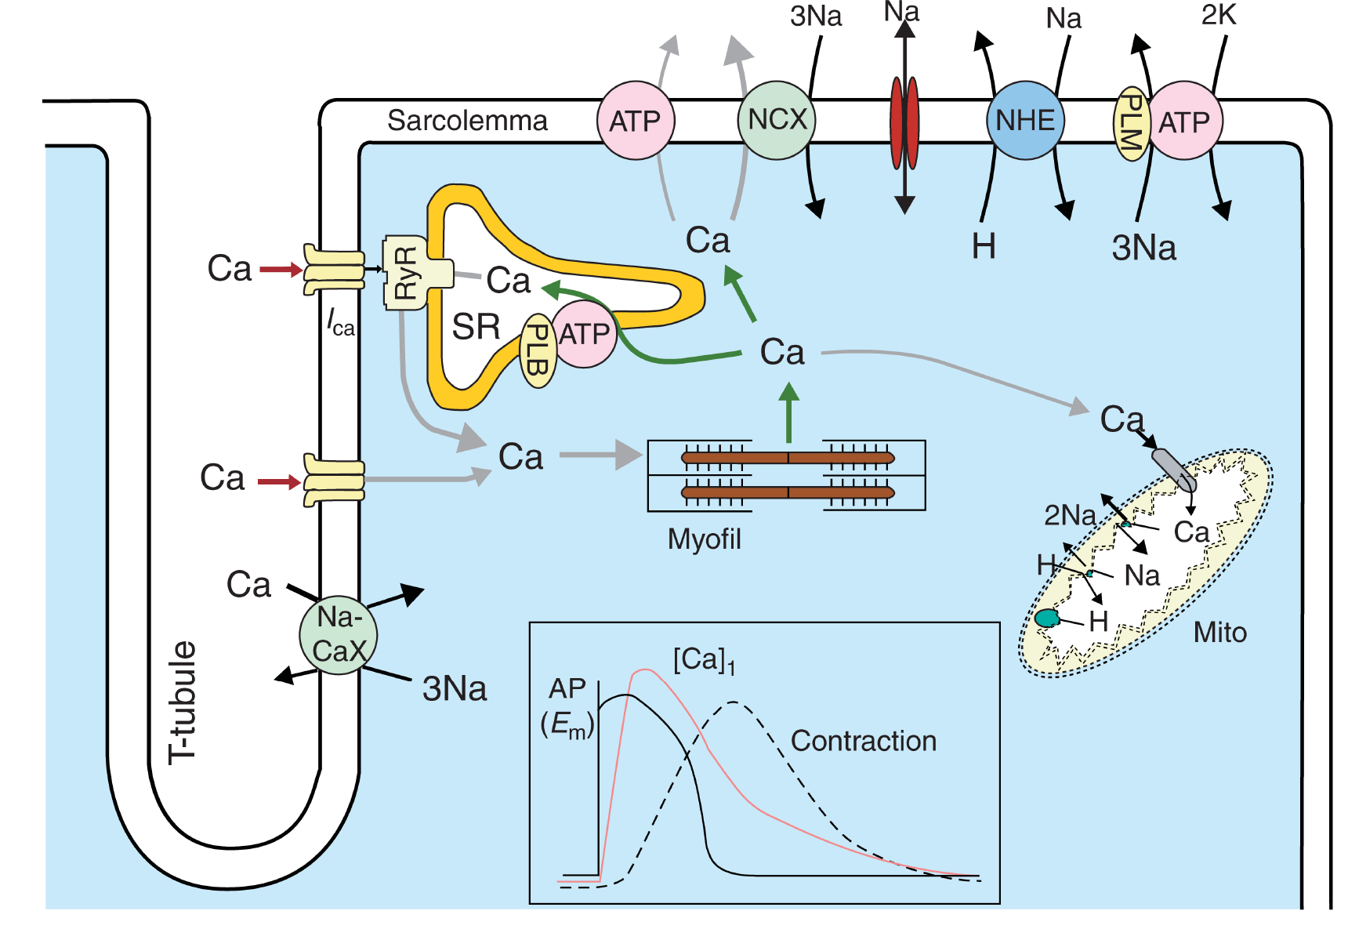
Relaxation-requires energy
BJA 98 (6): 707–21 (2007

Slide 7
Diastolic dysfunction definition
Inability of the ventricles to fill at low pressure
The end-diastolic pressure is 16-26 mm Hg
(normal EDP is < 12 mm Hg)
The atrial pressures that are needed to complete filling are even higher

Slide 8
Pathophysiology- two key terms
Increased filling pressures are due to
Abnormality of relaxation
Decreased compliance

Slide 9
Physiology: The stages
Isovolumic relaxation
Rapid filling
Diastasis
Atrial contraction

Slide 10
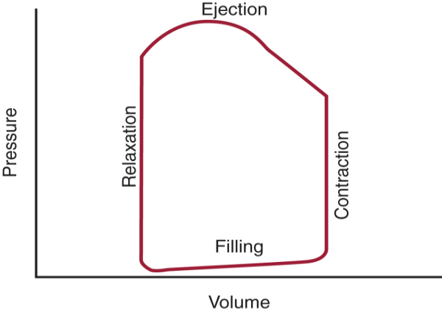
Physiology

Slide 11
Isovolumetric relaxation
AoVC
MVO

Slide 12
Isovolumetric contraction
Occurs between two closed valves
Active relaxation occurs during this time
The ventricular pressures continue to fall
Mitral valve opening creates “suction effect”

Slide 13
Physiology

Slide 14
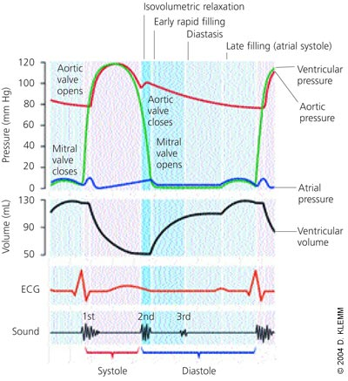
Rapid filling phase

Slide 15
Diastasis

Slide 16
Atrial “kick”

Slide 17
Active diastolic dysfunction
Abnormality of relaxation
Failure of energy dependent part of diastole
Myocardial ischemia
Hypertension
Aortic stenosis
Hypertrophic cardiomyopathy

Slide 18
Passive diastolic dysfunction
Increase in chamber stiffness
Infiltrative disorders ( amyloidosis)
Myocardial fibrosis
Progression from impaired relaxation

Slide 19
Physiology
End systole
End
Diastole

Slide 20
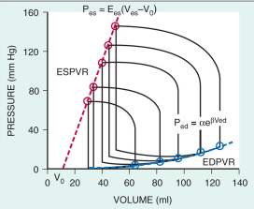

Slide 21
Physiology

Slide 22
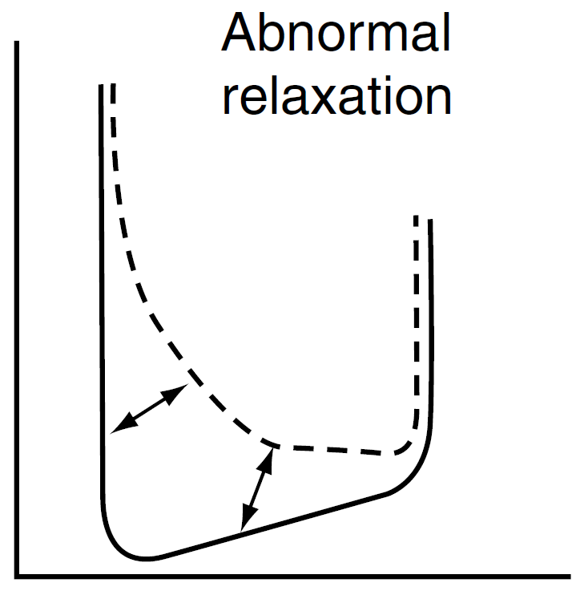
Impaired relaxation

Slide 23
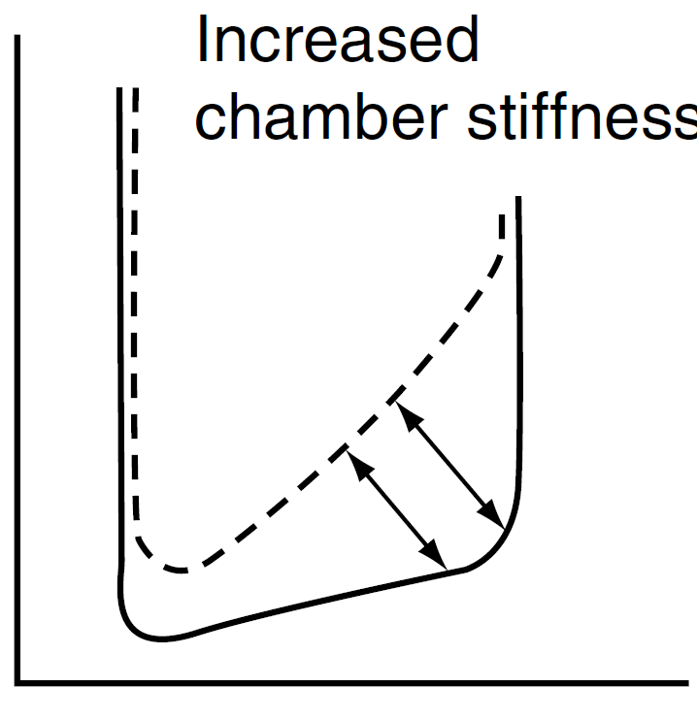

Slide 24
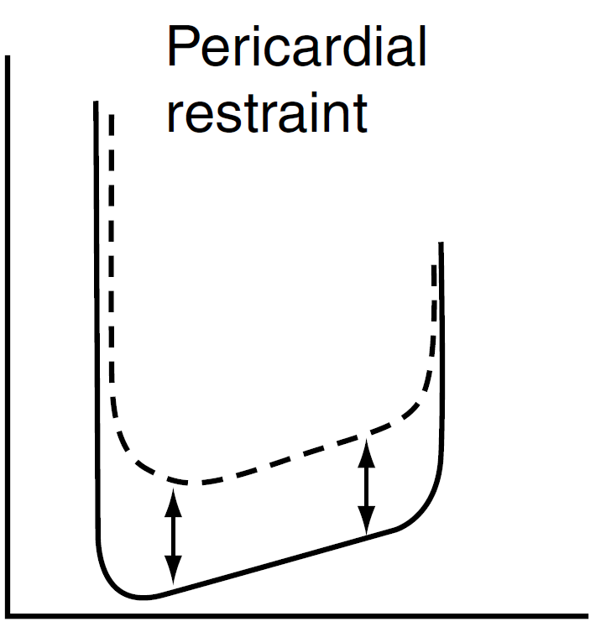

Slide 25
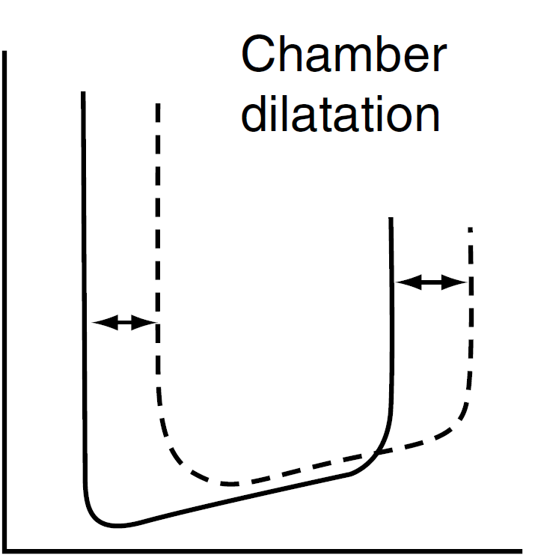

Slide 26
Diagnosis of diastolic dysfunction
Echocardiography

Slide 27
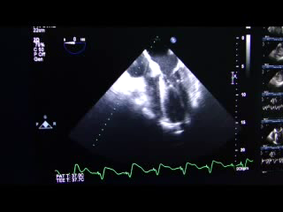
Transmitral Pulse Wave Doppler

Slide 28
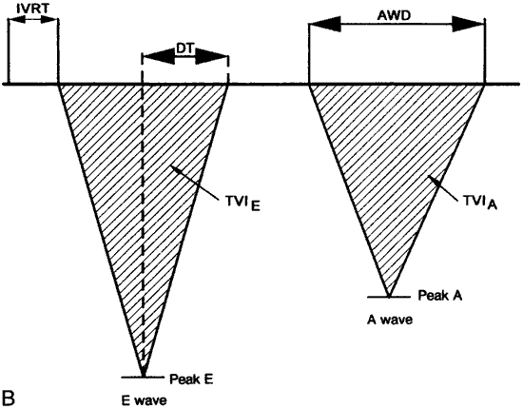
Transmitral Pulse Wave Doppler
E
A

Slide 29
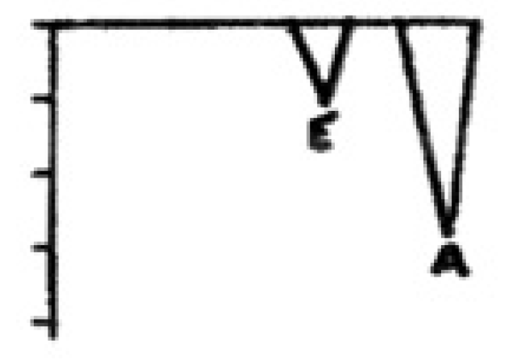
Stage I of diastolic dysfunction
Impaired relaxation

Slide 30
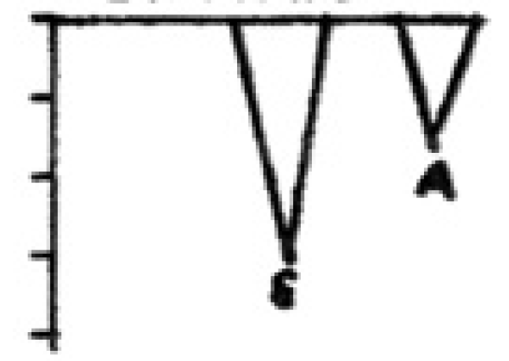
Stage II diastolic dysfunction
Pseudonormalization

Slide 31
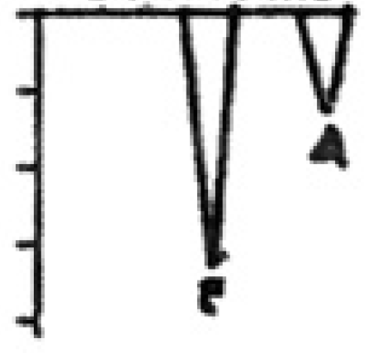
Stage III of diastolic dysfunction
Restrictive filling

Slide 32
Improvement to a worse grade
Tachycardia
Loss of atrial contraction
Volume excess

Slide 33
Improvement to a milder grade
Reduction in preload
    Reverse Trendelenburg
    Diuresis
    Amyl nitrate inhalation
    Valsalva maneuver
Relief of tachycardia
Return from AF to Sinus

Slide 34
Stage IV diastolic dysfunction
Irreversible restrictive filling pattern

Slide 35
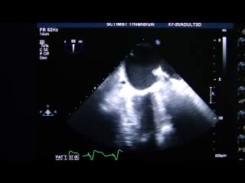
Pulmonary venous Doppler

Slide 36
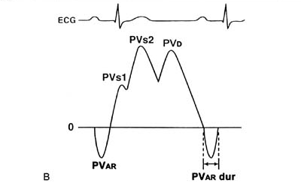
Pulmonary venous Doppler

Slide 37
Pulomnary venous Doppler
Impaired relaxation
D wave decreases in size
S/D ratio >1
Pseudonormal and Restrictive filling
Increase in D
S/D < 1
Increase in A wave duration

Slide 38
Other echocardiographic tools
Tissue Doppler imaging to assess mitral annular movement
Color M mode of the Mitral valve to assess the propagation velocity

Slide 39
Diastolic dysfunction vs. failure
Dysfunction is a physiologic or preclinical state
Abnormal relaxation and increased chamber stiffness compensated by increased LAP
The LV preload is maintained
When these mechanisms are stressed, diastolic heart failure ensues

Slide 40
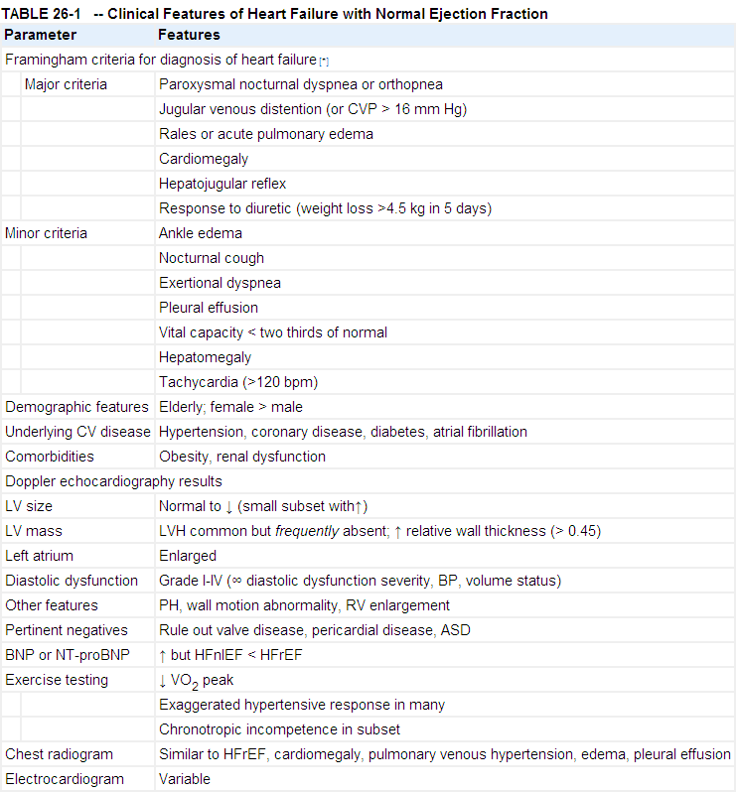
Braunwald 8th edition

Slide 41
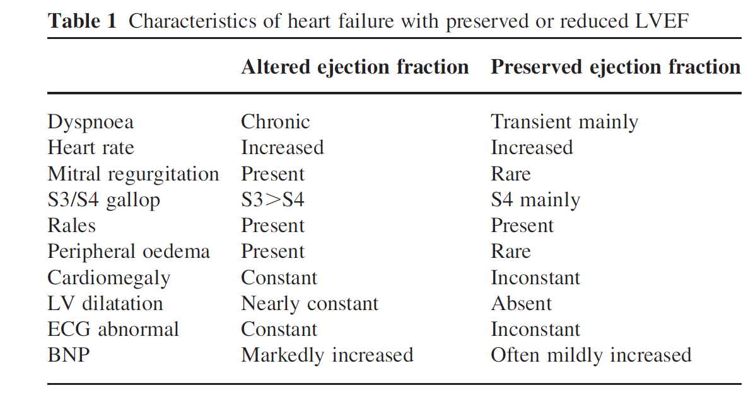

Slide 42
Diastolic heart failure
Definite
C/F of heart failure
Within72 hours
Echo evidence of normal LVEF
Echo evidence of diastolic dysfunction

Slide 43
Most likely diastolic heart failure
SBP >160 mm Hg
DBP> 100 mm Hg
Concentric LVH
Worsened by
  Tachycardia
  Volume bolus
Improved by
  Reducing HR
  Restoring sinus rhythm

Slide 44
When to suspect diastolic dysfunction
History of previous diastolic heart failure
Age > 70 years
Female sex
Uncontrolled hypertension
Myocardial ischemia
Diabetes mellitus
Comorbidities: Obesity, renal failure

Slide 45
Echo
Specifically documented
If not then, look for
  LVH –absence does not rule out!
  LA enlargement
  RV enlargement
  Pulmonary hypertension

Slide 46
Perioperative worsening
Deterioration in diastolic dysfunction
Myocardial ischemia
  Directly affects relaxation
  Induces rhythm disturbances
Hypovolemia
Tachycardia
Rhythms other than sinus

Slide 47
Perioperative worsening
Shivering
Anemia
Hypoxia
Electrolyte imbalances

Slide 48
Perioperative worsening
Post-op sympathetic stimulation
Post-op hypertensive crisis

Slide 49
Periop-risks
Delayed weaning from mechanical ventilation
Difficulty weaning from CPB
More use of vasoactive agents
Prolonged ICU stay & mortality

Slide 50
Conducting the anesthetic
Pre-operative evaluation
Functional status & exercise tolerance
Optimizing the perioperative drugs

Slide 51
Perioperative drugs
Diuretics
Beta blockers, calcium channel blockers
ACEI & ARBs
Statins
Antiplatlets

Slide 52
Monitoring - Major surgeries
Standard monitoring tools
Invasive arterial pressures
Monitoring volume status is important
Central venous pressures or Pulmonary artery catheter or TEE ?

Slide 54
GA or Regional
No definite recommendation either way
Epidural vs. spinal ?
Epidural wins

Slide 55
General anesthesia
IV induction & maintained with volatile agents and opioids
Greater hemodynamic instability

Slide 56
General anesthesia
Good induction practices
Consideration for age
Titrate to effect
Smooth take over from spontaneous-bag mask
Hpoxia, hypercarbia worsens PHT

Slide 57
GA-control of BP
Systolic BP within 20 % of baseline
Maintain diastolic BP
Keep pulse pressure < DBP

Slide 58
Control of BP
Rule of the 70s
Age >70 years
Pulse rate around 70s
DBP >70
Pulse pressure < 70

Slide 59
Drug combination for hemodynamics
Low dose nitroglycerin and titrated phenylephrine
Either agent alone can worsen the hemodynamics

Slide 60
Nitroglycerine + Titrated phenylephrine
Preserves vascular distensibility
Avoids reduction in preload
Maintains coronary perfusion pressure
Maintains stroke volume with minimal cardiac work

Slide 61
Management of hypertensive crisis
Sound anesthetic practices
Plan for post-op analgesia
Prevention of shivering
Intravenous calcium channel blocker
IV nitroglycerin

Slide 62
Post-op diastolic heart failure
Reduce preload
Diuretics
Use of nitrates
CPAP
Use of adrenaline, dobutamine, dopamine

Slide 63
Specific drugs for diastole
Milrinone
Phosphodiesterase III inhibitor
Inotropic, vasodilatory with minimal chronotropy
Increases calcium ion uptake to SR

Slide 64
Milrinone
Lusitropic effect more evident in heart failure
Bolus dose of 50µgm/Kg over 60 minutes
Infusion of 0.5 to 0.75µgm/Kg/min

Slide 65
Specific drugs for diastole
Levosimendan
Sensitizes the contractile elements to calcium
Has a vasodilator effect
Improves both systolic and diastolic function

Slide 66
Thank you

